Slide 1

CC10 · MANAGEMENT BRIEFING
Own the outcome.
Keep the options.
A working reference for a sovereign, AI-assisted digital ecosystem.
Reference prototype · Distribution preview · Enterprise path

Slide 2

THE MANAGEMENT QUESTION
Convenience became dependency
Identity, data, collaboration, social media and AI now follow unrelated vendor decisions.
The risk is not one tool.
It is an operating model nobody fully owns.
CC10 starts by defining accountable outcomes, authoritative data and exit paths — then selects replaceable components.
02

Slide 3
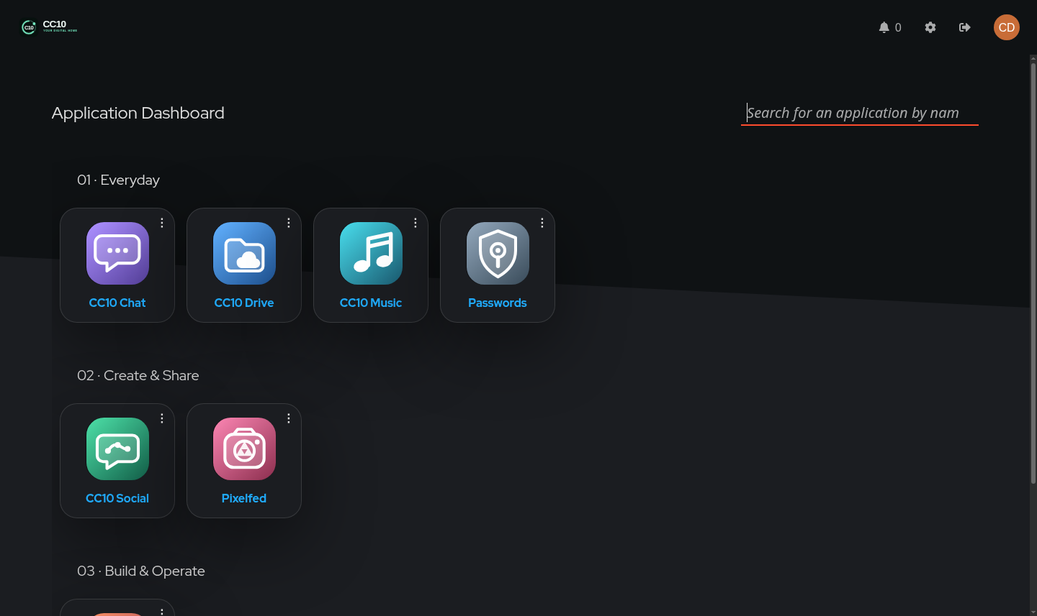
THE PRODUCT MODEL
Users receive one digital home
A role-based launcher turns independent services into a coherent daily experience.
ONE IDENTITY
Only the right apps appear.
Daily users, creators and operators share the platform without sharing the same permissions.
The browser stays the interface; infrastructure stays behind a stable product model.
03

Slide 4
CAPABILITY OWNERSHIP
One visible surface owns each job
Clear ownership reduces duplicate tools, inconsistent records and support ambiguity.
DRIVE
CHAT
SOCIAL
STUDIO
OPERATOR
Private files
and groupware
Private
conversation
Public
participation
Research and
media creation
Typed system
control
Backends may change. The user's mental model should not.
04

Slide 5

BUSINESS VALUE
Sovereignty creates operational leverage
The outcome is optionality — not self-hosting for its own sake.
PORTABILITY
Move data and workflows without rebuilding the whole workplace.
CONTINUITY
Recovery knowledge and evidence survive people and vendors.
LEVERAGE
AI accelerates planning and delivery inside accountable boundaries.
05

Slide 6
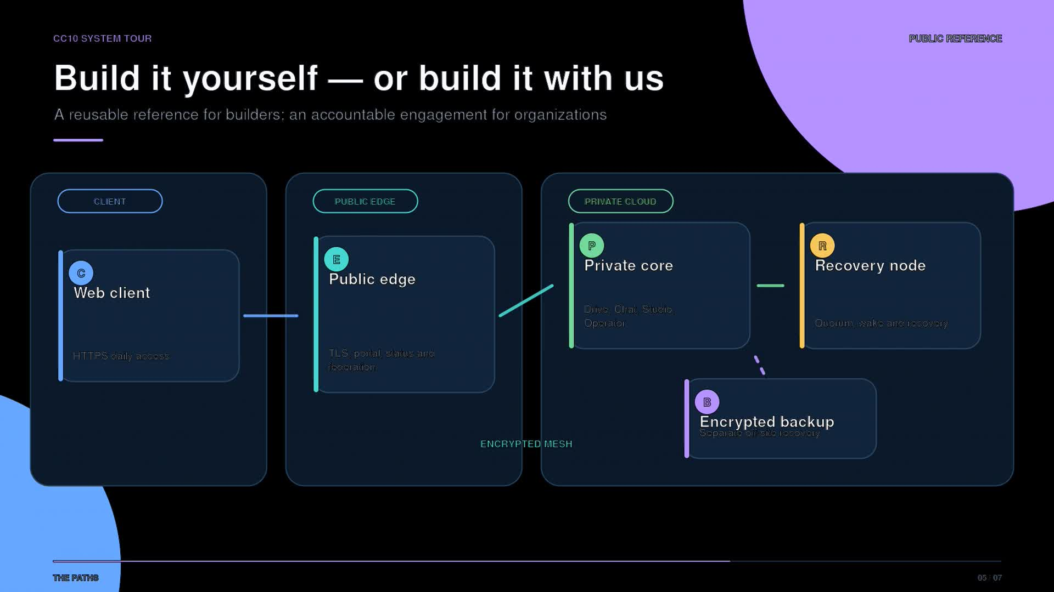
GOVERNANCE
Convenience needs accountable boundaries
Shared identity improves access; policy, evidence and recovery keep it trustworthy.
IDENTITY
Who is this?
ROLE
What may they use?
ACTION
What will change?
EVIDENCE
Did it work — and can it recover?
06

Slide 7
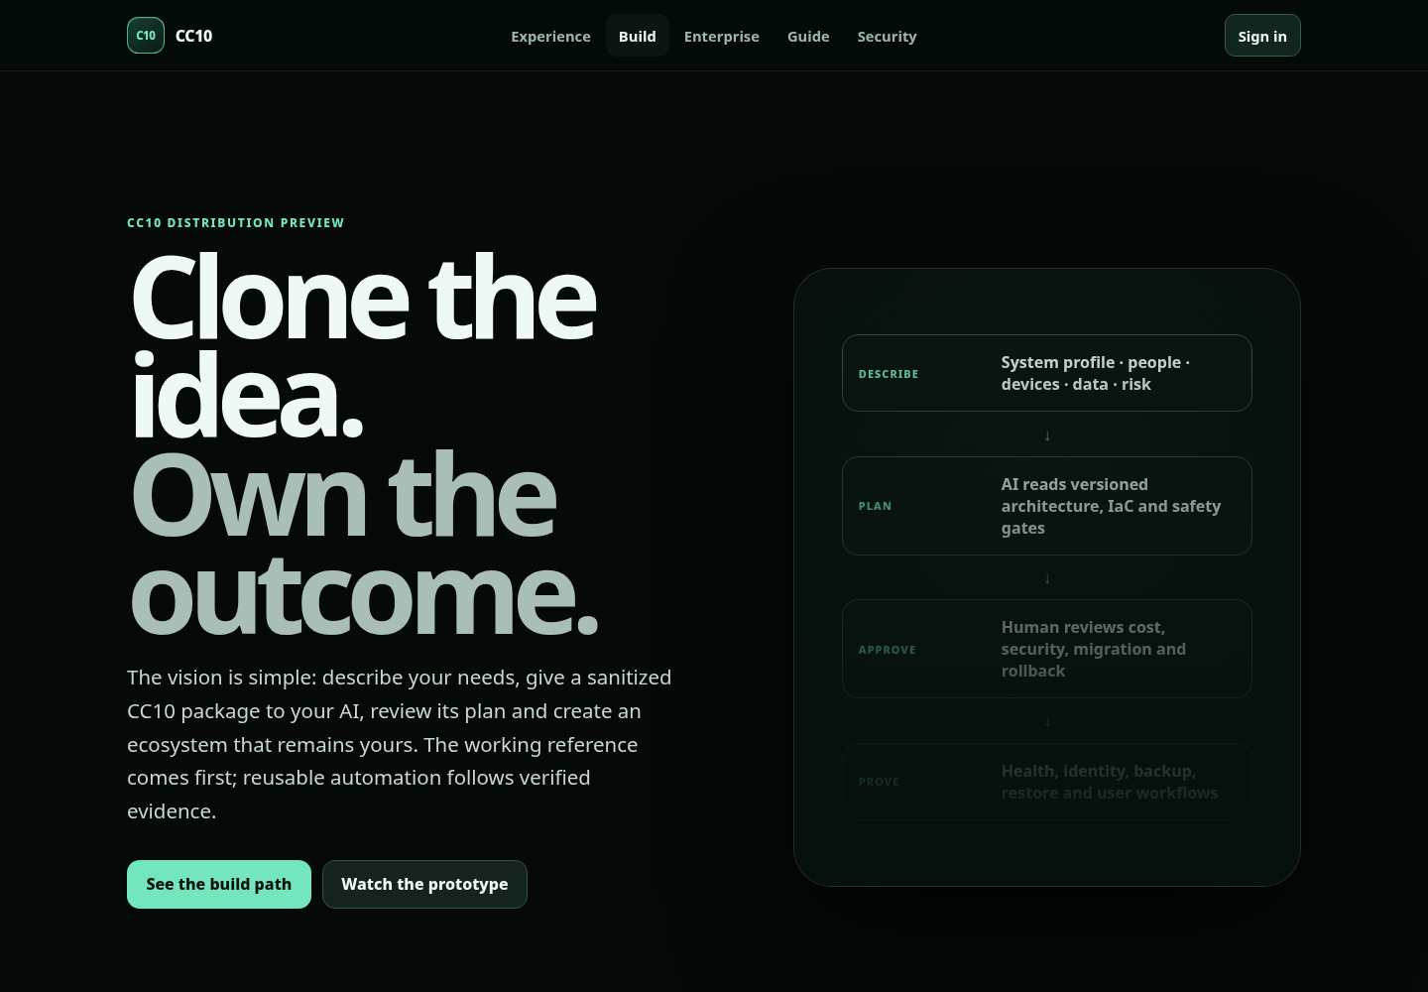
DELIVERY
Prototype, standardize, harden, operate
AI prepares an environment-specific plan; source control, approval and acceptance remain authoritative.
01
CLONE
Sanitized reference
02
DESCRIBE
System profile
03
APPROVE
Plan and risk
04
PROVE
Acceptance evidence
07

Slide 8
MATURITY
Precise claims build more trust than a green dashboard
CC10 distinguishes what is live, what is reusable and what still requires proof.
LIVE
VERIFIED
OPEN GATES
Reference system
Identity and launcher
Real app workflows
Typed health checks
Public-edge IaC
English companion UX
Local voice and video
Sanitized media
Public licence
Clean-room install
Recurring restore proof
Enterprise controls
Working reference today. Distribution in progress.
08

Slide 9
THE FIRST DECISION
Choose one outcome
worth owning.
Map its people, data, workflow and exit path. Prove daily use and recovery with a bounded pilot.
SELF-BUILD PREVIEW · ENTERPRISE ENGAGEMENT
cong42.de/enterprise · cong42@proton.me

