Slide 1
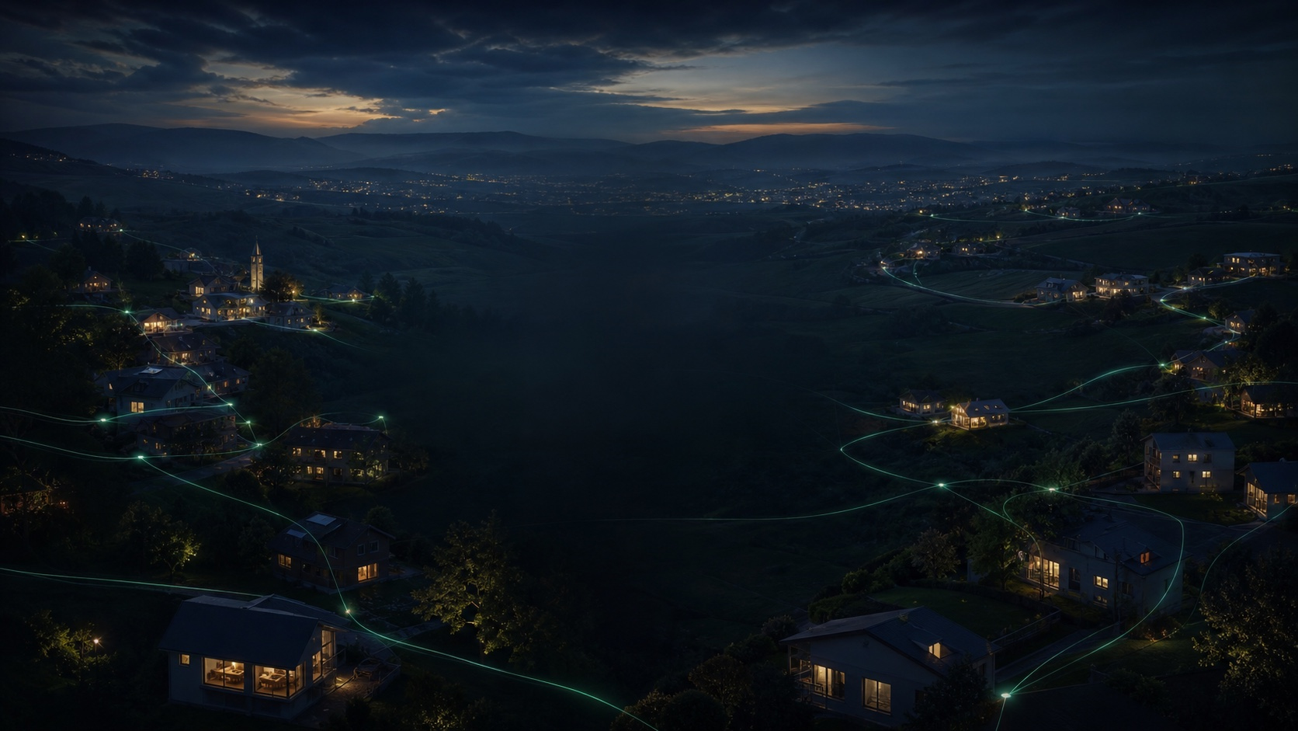
CC10 · CUSTOMER PITCH
Your digital world.
Under your control.
A live European reference for a private, open and AI-assisted ecosystem.
cong42.de

Slide 2

WHY NOW
You did not choose one lock-in
It accumulated across identity, files, communication, social media, devices and AI.
Every service can be convenient.
The combined system can still be impossible to leave.
CC10 creates one understandable product while preserving data ownership, replaceable components and a documented exit path.
02

Slide 3
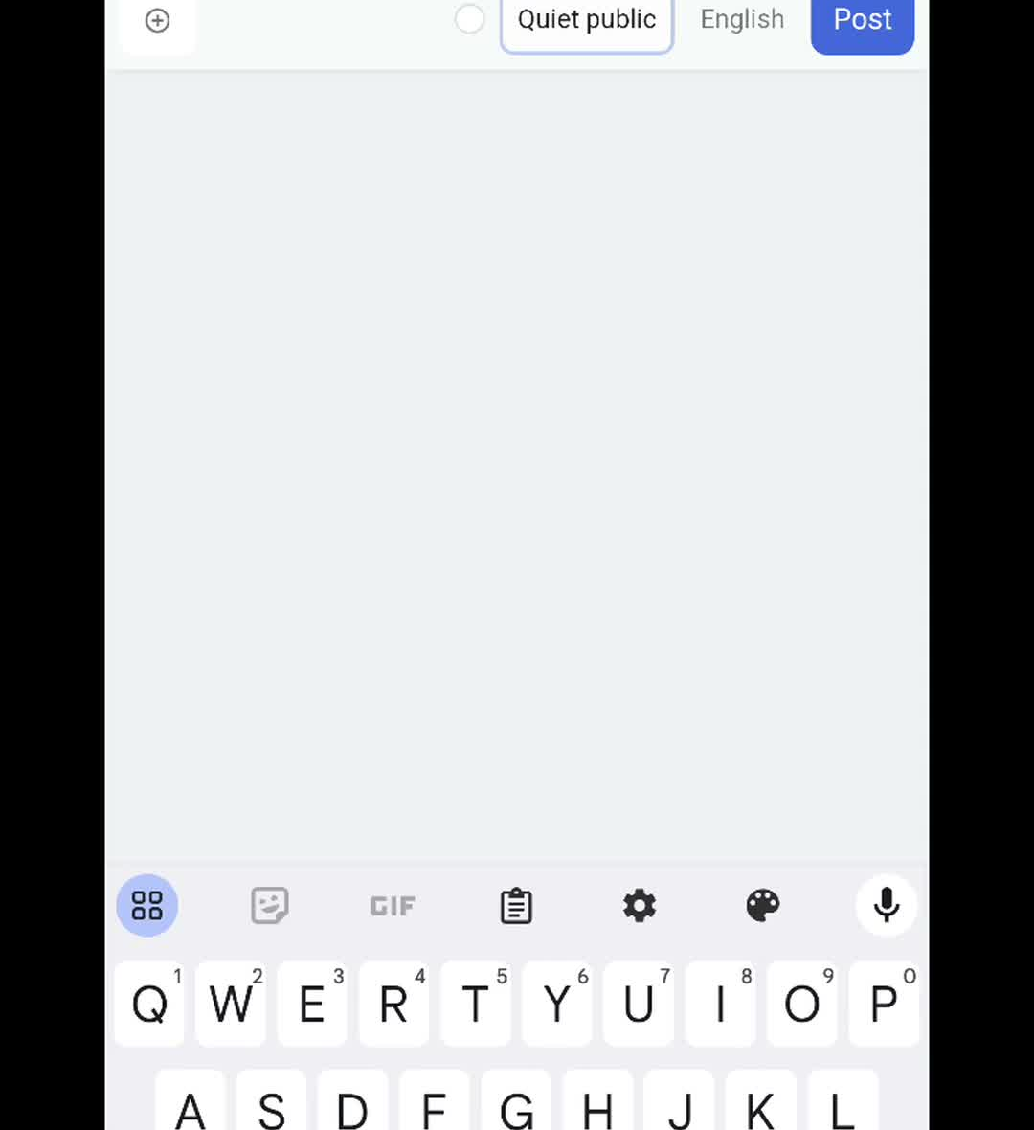
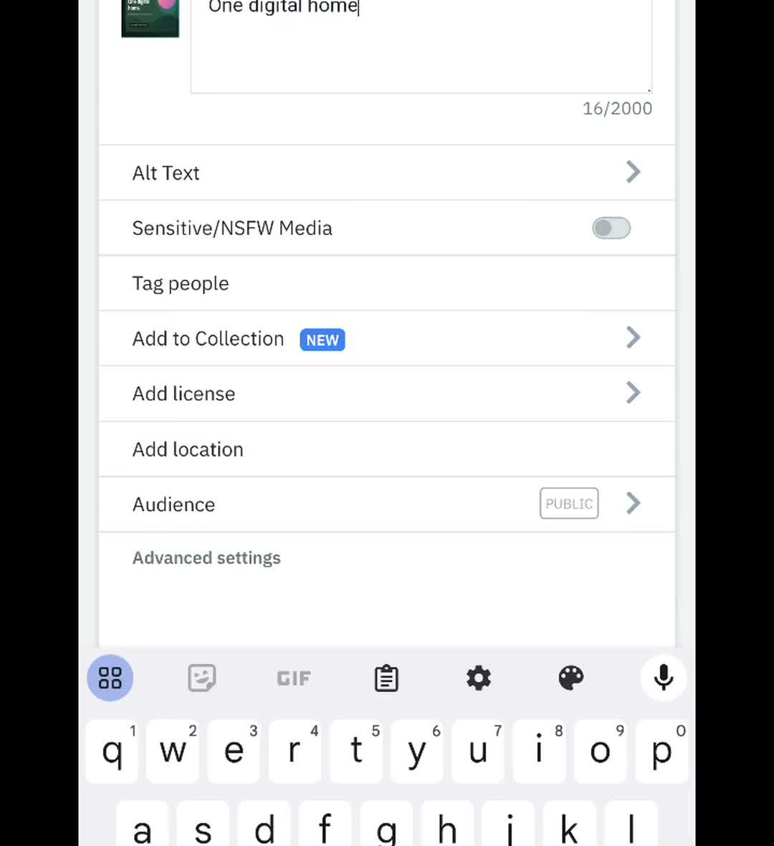
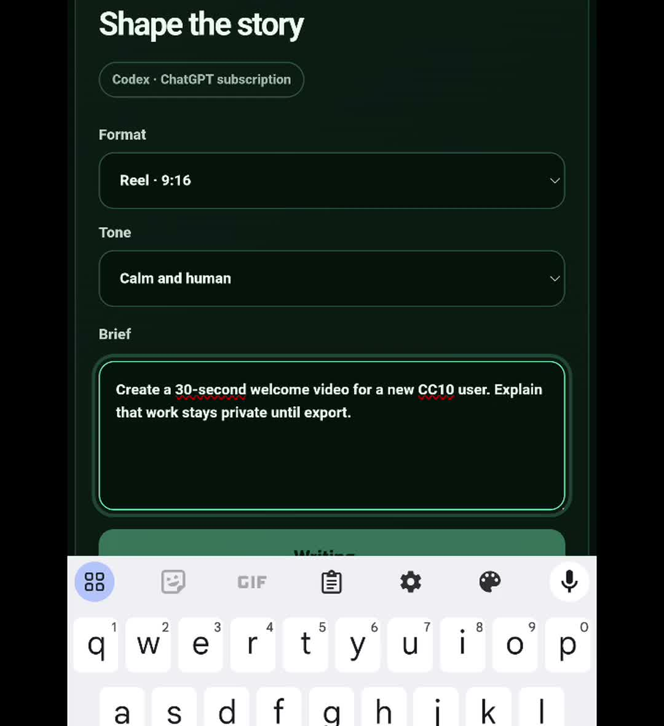
LIVE PROOF
Real applications. Real workflows. Real sound.
CC10 demonstrates use — not a wall of logos.
CC10 SOCIAL
PIXELFED
VIDEO STUDIO
03

Slide 4
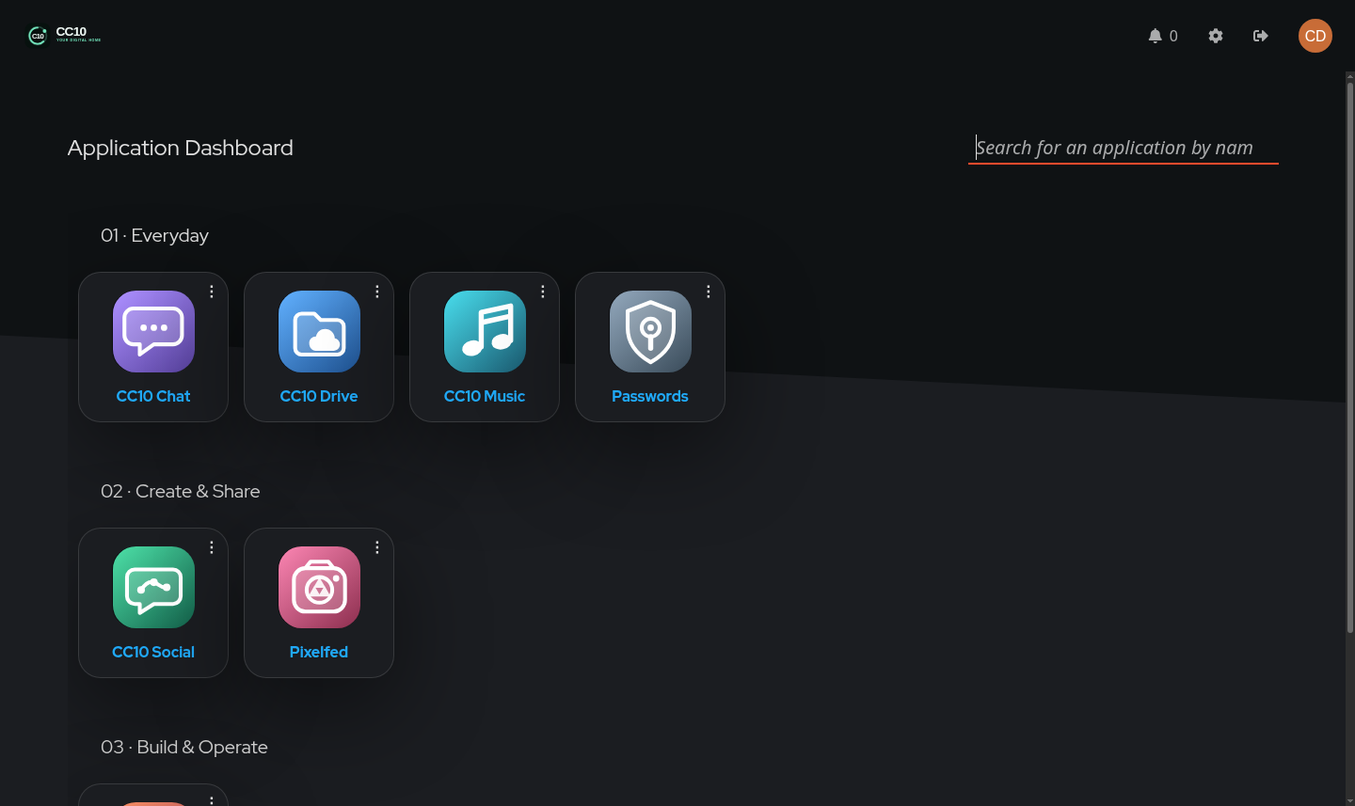
EXPERIENCE
One sign-in becomes a focused digital home
People see the applications for their role — and no infrastructure catalogue.
EVERYDAY
Drive · Chat · Music · Passwords
CREATE AND SHARE
Social · Pixelfed · Notebook · Video Studio
BUILD AND OPERATE
System · OpenHands · Git
04

Slide 5
CREATION
Checked knowledge becomes communication
Tutorials, podcasts, reels, films and campaigns share one reviewable workflow.
SOURCE
Ground the idea
DRAFT
Use a trusted AI adapter
VOICE
Render locally with Kokoro
REVIEW
Approve before publishing
No public subscription proxy. No automatic publishing.
05

Slide 6
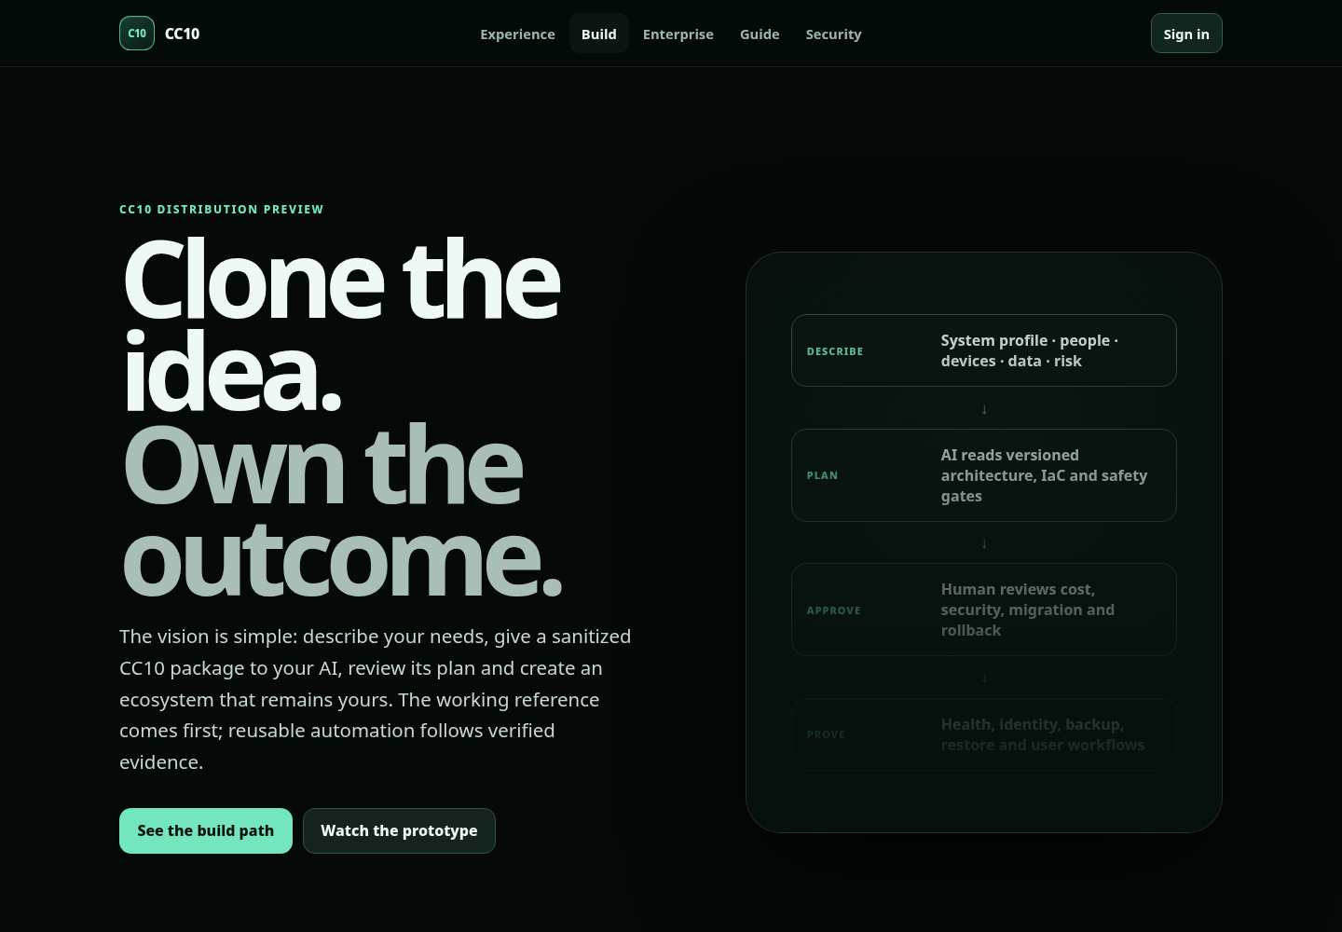
TWO PATHS
Build it yourself — or build it with us
The same reference supports experimentation and an accountable enterprise path.
SELF-BUILD PREVIEW
Clone. Describe. Review. Prove.
Sanitized reference, system profile, AI bootstrap prompt and acceptance criteria. Public release gates remain visible.
ENTERPRISE
Assessment · Architecture · Migration · Hardening · Adoption · Operations
06

Slide 7
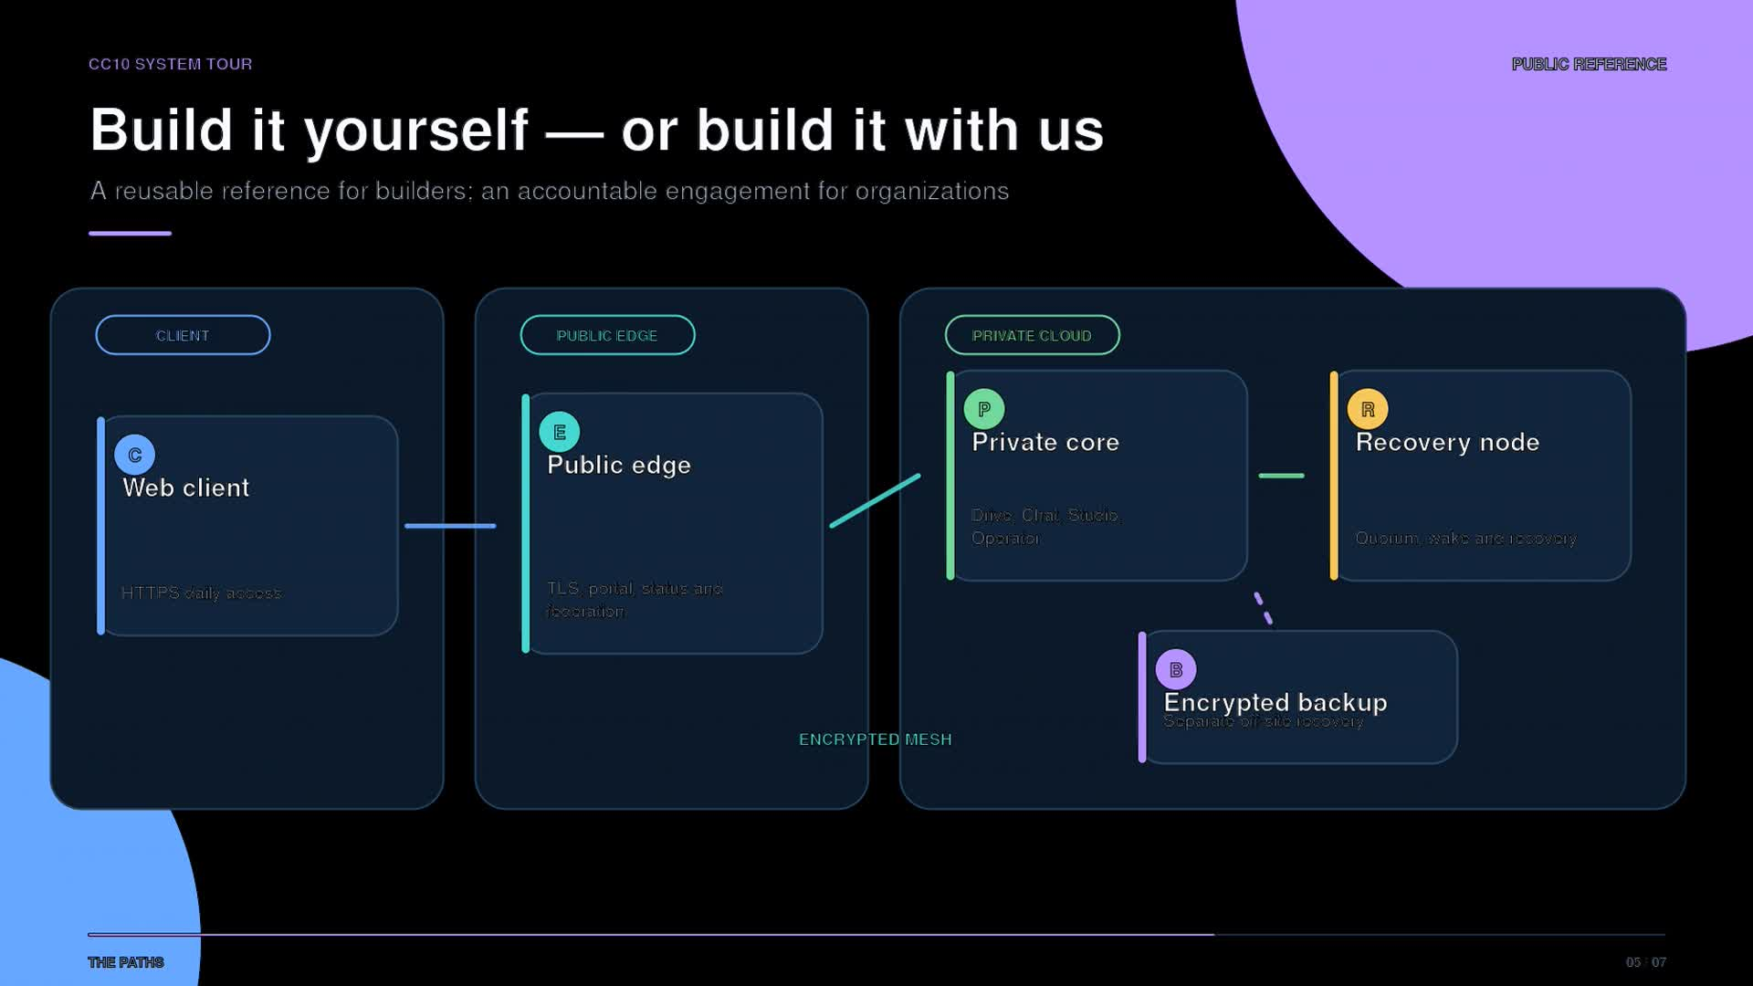
ARCHITECTURE
Thin clients. Private core. Replaceable edge.
Stable interfaces keep the product coherent while placement and engines evolve.
07

Slide 8
HONEST MATURITY
No sovereignty theatre
The reference is useful because it distinguishes proven operation from unfinished release gates.
LIVE
Identity, launcher, apps, workflows and operator checks
REUSABLE
Verified edge IaC, prompts, profiles and acceptance model
OPEN
Licence, sanitized export and independent clean-room install
Security controls are real. Formal certification is not claimed.
08

Slide 9

START WITH ONE OWNED OUTCOME
Explore. Pilot.
Recover. Evolve.
Choose one workflow where continuity or lock-in matters. Prove daily use and recovery before you scale.
cong42.de/enterprise
cong42@proton.me

